Slide 1
Circuit Mapping with GIS
Joshua Smith, Undergraduate Research Assistant
Dr. Elham Makram, Faculty Advisor
The Holcombe Department of Electrical and Computer Engineering

Slide 2
Introduction
Feeder Reduction
Electrically equivalent feeder model, topographically different
Quasistatic Timer Series Analysis comparison to historical data
Circuit Mapping with GIS
Program flow with example
Future work with idealized program flows

Slide 3
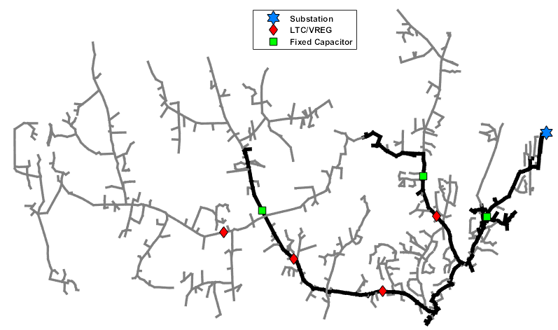
Feeder Redution

Slide 4
Feeder Reduction

Slide 5
Circuit Mapping with GIS
CYME
Shape File
OpenDSS
Coordinates
Determine DG Location on Feeder
Suitable Location
ID
Bus1
Bus2
Lat
Long
Update
Analysis

Slide 6
Circuit Mapping with GIS

Slide 7
Circuit Mapping with GIS

Slide 8
Circuit Mapping with GIS

